Slide 1

Car Dealership Analysis

Slide 2
Introduction
In this project for a chain of car dealerships, few visualizations are created to allow us to understand car sales and profits for each dealer.
Tools used
Microsoft excel for cleaning, analysis and visualization

Slide 3
Sales Analysis
No of cars sold by a dealer, dealer who sold the highest no of cars.

Slide 4
Number of cars sold per model.

Slide 5
Financial Analysis
Profits made by dealers in 2018 and 2019.

Slide 6
Profits made by car models per month.

Slide 7
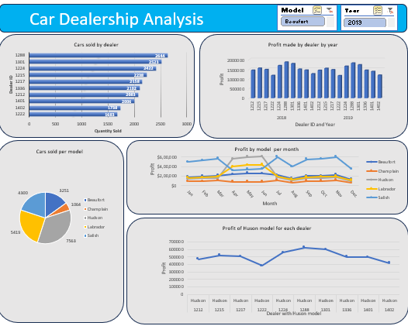
Final dashboard

Slide 8
Insights
Dealer with id 1288 sold highest number of cars 2644.
Hudson model cars are sold more when compared to other models.
Dealer with id 1288 gained more profits in both 2018 and 2019.
Way forward
Car sales are higher in between the months march and July, promote more sales through advertising.
Encourage other dealers to follow methods used by dealer 1288.

Slide 9
Thank You
Any Questions?

